Slide 1
Qualitative Activity Recognition - Assess the Quality of Execution of Weight Lifting Exercise
By Qing Deng

Slide 2
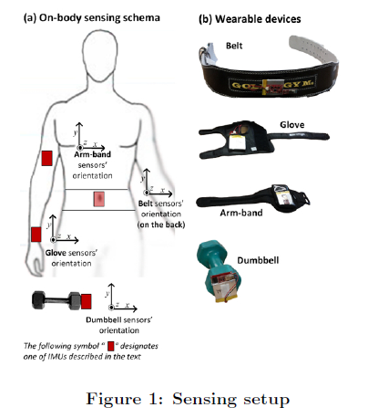
Data Description
Data are recorded from 9 freedom Razor inertial measurement units (IMU), which provide three-axes acceleration, gyroscope and magnetometer.
Data size: p=53, n=18,000
5 Levels:
Class A : exactly according to the specification;
Class B : throwing the elbows to the front;
Class C : lifting the dumbbell only halfway;
Class D : lowering the dumbbell only halfway;
Class E : throwing the hips to the front.

Slide 3
Train set
N=200
N=18,000
KNN, QDA,
Random Forest.
Train set
N=400
KNN, QDA,
Random Forest.
Test,
N=9,000
Train
N=9,000
Train set
N=600
KNN, QDA,
Random Forest.
Randomly select n observations from train data set, creating 450 new train sets.
KNN,LDA, QDA,
Tree, Bagging, Boosting,
Random Forest
Neural network
Train set
N=9,000

Slide 4
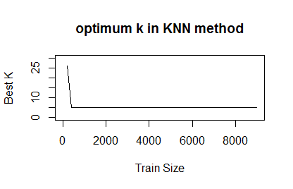
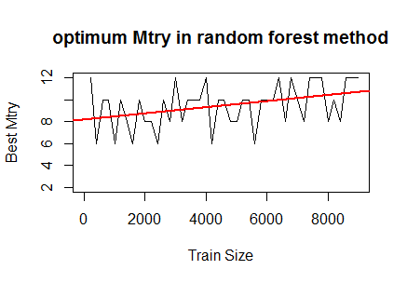
Find optimum k and mtry using 10-fold CV
KNN:
K=5,6,7,8,9,10,12,14,16,18,20,22,24,26,28,30
Random Forest:
mtry = 2,4,6,8,10,12

Slide 5
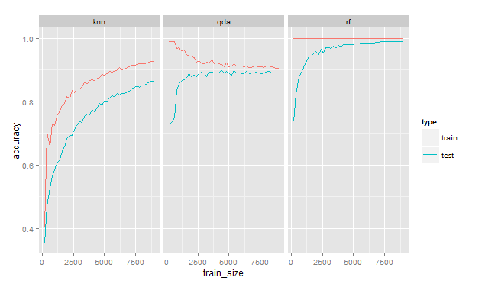
Accuracy on train and test data

Slide 6
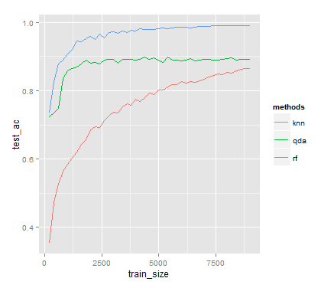
Accuracy on test data

Slide 7
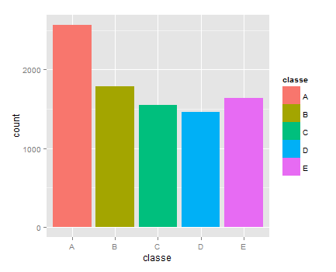
Identify the best classification model train=9,000 ; test=9,000

Slide 8
Identify the best classification model train=9,000 ; test=9,000
No. | Method | Accuracy with 10-fold CV | Tuning Parameter
1 | Random Forest | 0.9935 | mtry=12
2 | Bagging | 0.9808 | vars=?
3 | QDA | 0.8707 | ---
4 | KNN | 0.8646 | k=5
5 | LDA | 0.6968 | ---
6 | TREE | 0.4933 | cp=0.03264605
7 | Neural Network | 0.4384 | size = 5 and decay = 0.1

Slide 9
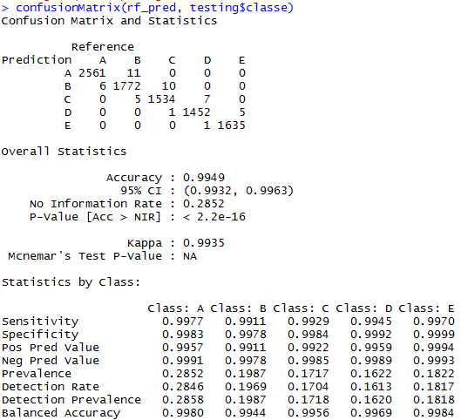

Slide 10
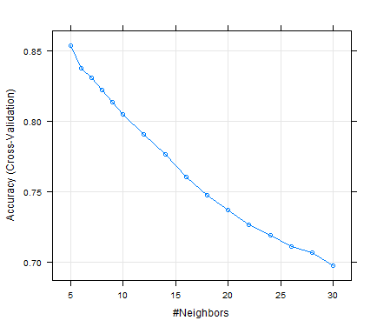
KNN method: accuracy decrease as k value increase

Slide 11
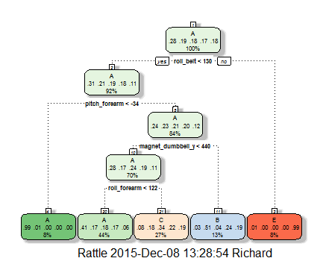
TREE PLOT:

Slide 12
Thank you!

